Slide 1
CS310 Operating Systems Lecture 41: Solid State Drive (SSD) – Flash Drive
Ravi Mittal
IIT Goa

Slide 2
References
CS162, Operating Systems and Systems Programming, University of California, Berkeley
Various sources on the Internet

Slide 3
Reading
CS162, Operating Systems and Systems Programming, University of California, Berkeley
Book: Operating System Concepts, 10th Edition, by Silberschatz, Galvin, and Gagne

Slide 4
Lecture Contents
Flash Storage – Introduction
Flash Operation
Flash Architecture

Slide 5
Last Class

Slide 6
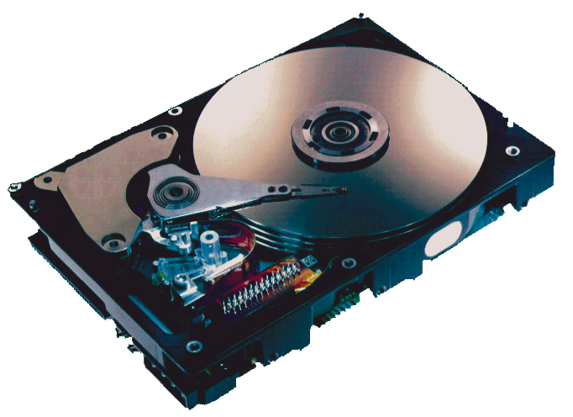
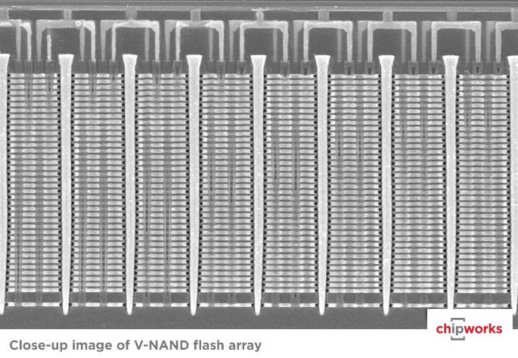
Storage Technologies
Magnetic Disks
Store on magnetic medium
Electromechanical access
Nonvolatile (Flash) Memory
Store as persistent charge
Implemented with 3-D structure
100+ levels of cells
3 bits data per cell
Bryant and O’Hallaron, Computer Systems: A Programmer’s Perspective, Third Edition

Slide 7
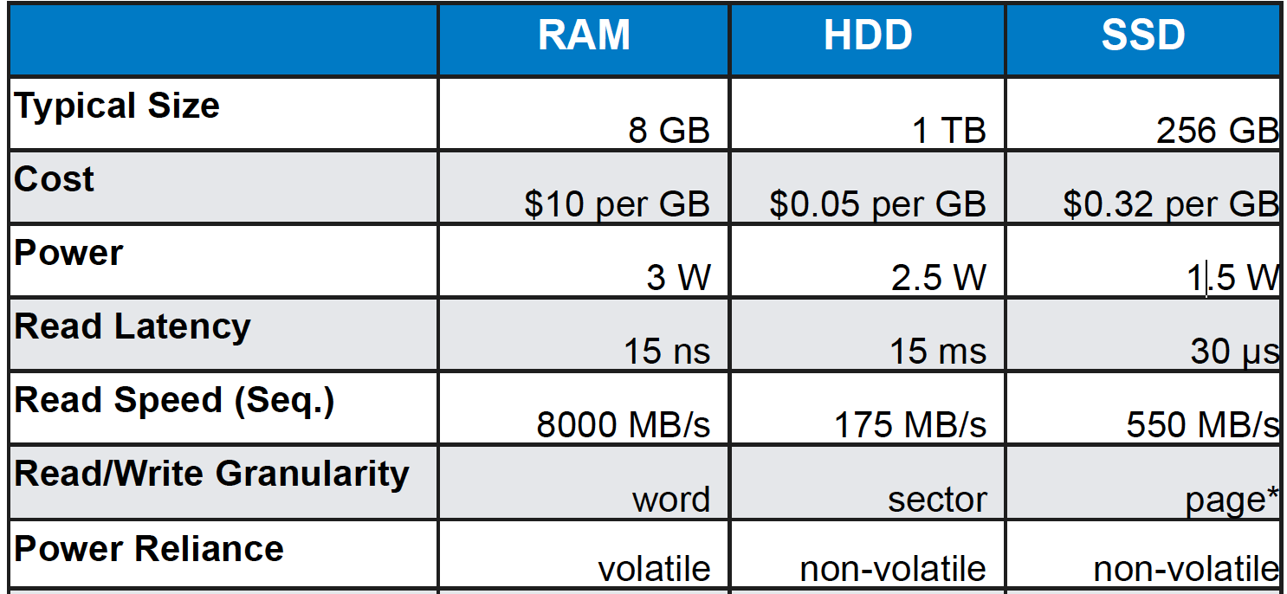
RAM vs Hard Disk vs SSD - 2018
In SSD Each cell has limited program/erase lifetime (thousands, for modern devices) – Cells become slowly less reliable
CS162 Univ of California Berkeley

Slide 8
Popular Storage Devices
Magnetic Disks
Flash Memory
Rarely becomes corrupted
Traditionally: large capacity at low cost
Block level random access
Slow performance for random access
Better performance for sequential access
Rarely becomes corrupted
Increasingly larger and cheaper
Block level random access
Good performance for reads, worse for random writes
Have to erase data in large blocks
Challenge: Wear Levelling
CS162 Univ of California Berkeley

Slide 9
Emergence of SSDs

Slide 11
Flash Storage - Introduction

Slide 12
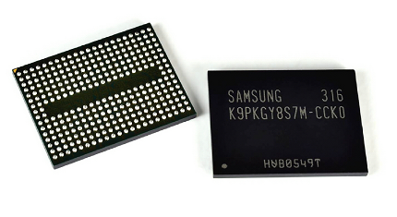
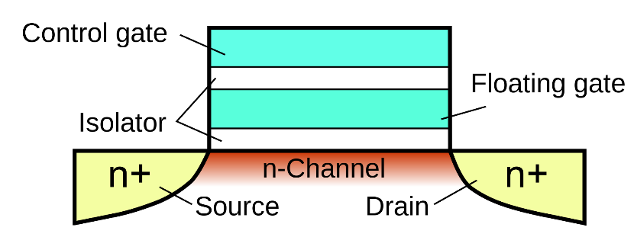
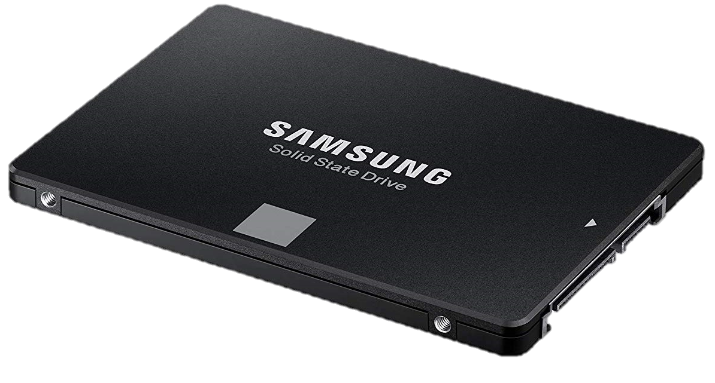
Flash Storage
Most prominent solid state storage technology
NAND- and NOR- flash types available
NOR-flash can be byte-addressed, expensive
NAND-flash is page addressed, cheap
Except in very special circumstances, all flash-storage we see are NAND-flash
SD Cards, USB Drives, SSDs are based on NAND memory
NAND: Each cell can not be written and deleted independently
NOR: each cell can be handled independently

Slide 13
The Flash Cell
Flash cells store data in floating gate by charging it at high voltage
Encode bit by trapping electrons into a cell

Slide 14
The Flash Cell
Single-level cells (SLC)
Single bit stored within a transistor
faster, more lasting (100K writes before wear out)
Multi-level cells (MLC)
Many bits can be stored in a cell by differentiating between the amount of charge in the cell
It can store 2, 3, even 4 bits
It cheaper to manufacture
It wears out faster (1k to 10K writes)
It is more fragile (stored value can be disturbed by accesses to nearby cells)
Single-Level Cell (SLC), Multi (MLC), Triple (TLC), Quad (QLC)
Typically cheaper, but slower with more bits per cell
CS162 Univ of California Berkeley

Slide 15
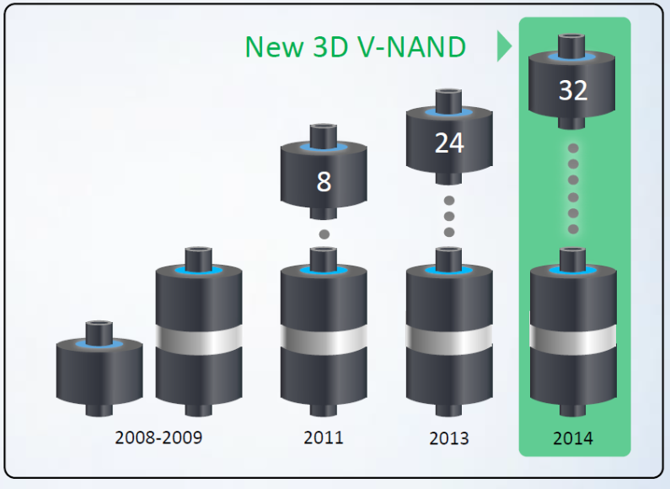
3D NAND-Flash
3D NAND is a type of non-volatile flash memory in which the memory cells are stacked vertically in multiple layers
Creates larger storage capacity
Smaller footprint
Shorter overall connections for each memory cell
Lower cost per byte compared to 2D NAND

Slide 16
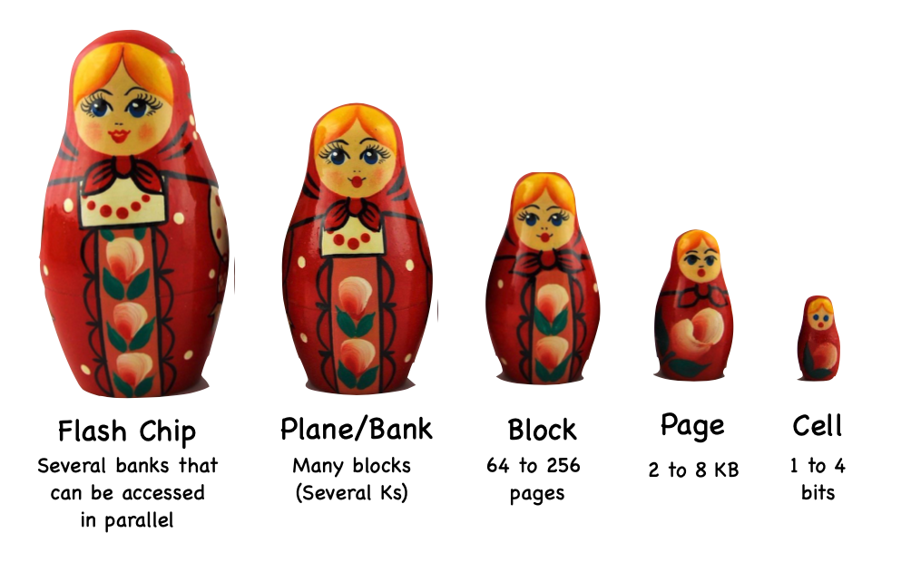
SSD Storage Hierarchy

Slide 17
NAND Flash Die Layout
(image courtesy of AnandTech)

Slide 18
Die, Planes, Blocks, Pages
Each package (chip) contains one or more dies (for example one, two, or four)
The die is the smallest unit that can independently execute commands or report status
Each die contains one or more planes (usually one or two)
Identical, concurrent operations can take place on each plane, although with some restrictions
Each plane contains a number of blocks
Block is the smallest unit that can be erased
Each block contains a number of pages
Page is the smallest unit that can be programmed (i.e. written to)

Slide 19
Die, Planes, Blocks, Pages
Write take place on a page
typically 8-16KB in size
Erase operations take place to a block
4-8MB in size
A block needs to be erased before it can be programmed again

Slide 20
Interesting way of working!
There is no update operation for flash
No undo or rewind mechanism for changing what is currently in place
Just the erase operation
An erase operation on a flash chip clears the data from all pages in the block
If some of the other pages contain active data (stuff you want to keep)
Either have to copy it elsewhere first
Or don’t do erase

Slide 21
Of banks, blocks, cells
Flash chips organized in banks
Banks can be accessed in parallel
Blocks: 128 KB/256KB
(64 to 258 pages)
Pages: Few KB
Cells: 1 to 4 bits
Distinction between blocks and pages important in operations!
Bank
Block
Block
Page
Page
Page
Page
Cell
Cell
Cell
Cell
Cell
Cell
Cell
Cell
Cell
Cell
Cell
Cell
Cell
Cell
Cell
Cell
CS162 Univ of California Berkeley

Slide 22
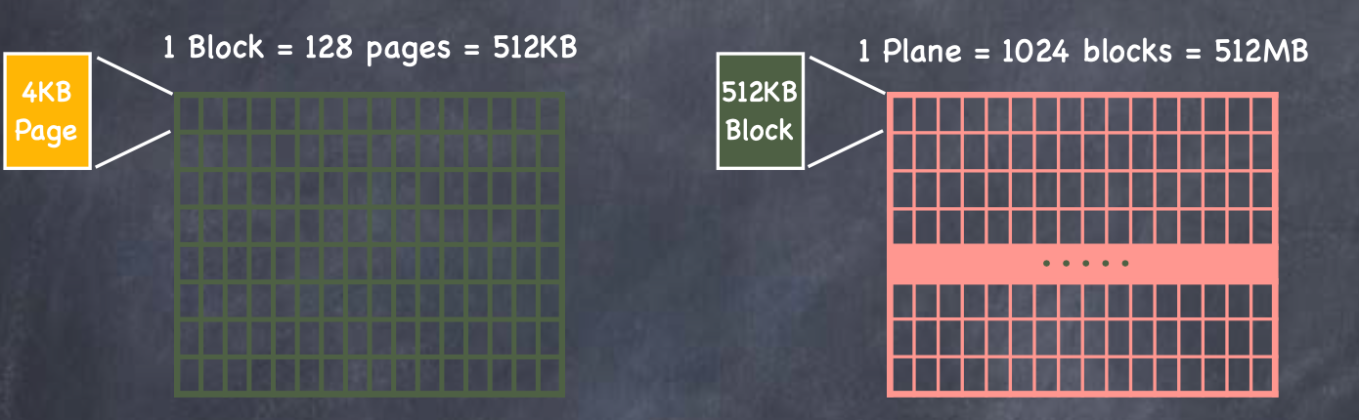
Example: NAND Flash Units

Slide 23
SSD Operations
Erase
Before a block can be written it is erased
Set to logical 1
Under the hood: erase sets all bits to 1, write can only change some to 0
Operation takes several milliseconds – high latency
Write a page
Tens of microseconds to hundreds of microseconds
Reading a page
Read takes 10s of micro seconds

Slide 24
Flash Drive - Data
Flash drive specs 4 KB page
3ms to erase erasure block
512KB erasure block
50μs read page/write page
How long to naively read/erase/and write each page?
128 x (50 x 10-3) + 3 + 128 x (50 x 10-3) = 15.8ms per write
Read Block, Erase Block, Write Block

Slide 25
Flash Operations: Erase, Write, Read

Slide 26
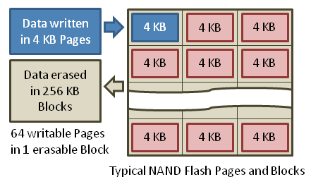
SSD Architecture – Writes (I)
Writing data is complex! (~200μs – 1.7ms )
Write be done only on empty pages in a block
Erasing a block takes ~1.5ms
Controller maintains pool of empty blocks by coalescing used pages (read, erase, write), also reserves some % of capacity
https://en.wikipedia.org/wiki/Solid-state_drive
CS162 Univ of California Berkeley

Slide 27
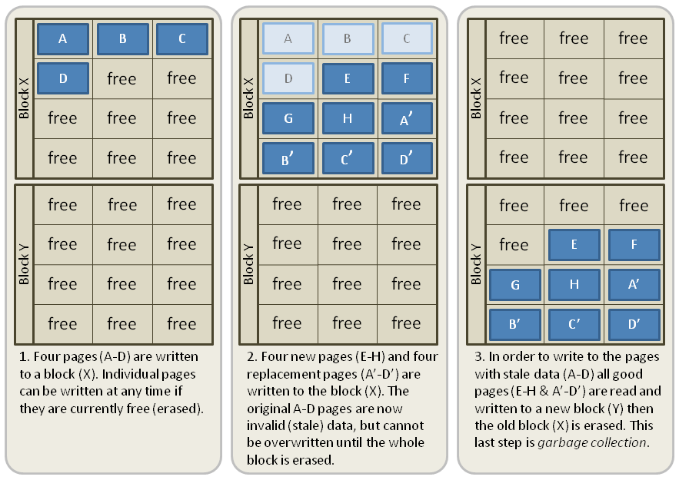
SSD Architecture – Writes (II)
Write A, B, C, D
https://en.wikipedia.org/wiki/Solid-state_drive
CS162 Univ of California Berkeley

Slide 28
SSD Architecture – Writes (II)
Write A, B, C, D
Write E, F, G, H and A’, B’, C’, D’
Record A, B, C, D as obsolete
https://en.wikipedia.org/wiki/Solid-state_drive
CS162 Univ of California Berkeley

Slide 29
SSD Architecture – Writes (II)
Write A, B, C, D
Write E, F, G, H and A’, B’, C’, D’
Record A, B, C, D as obsolete
Controller garbage collects obsolete pages by copying valid pages to new (erased) block
CS162 Univ of California Berkeley

Slide 30
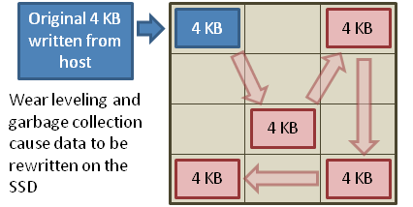
SSD Architecture – Writes (III)
CS162 Univ of California Berkeley
Write and erase cycles require “high” voltage
Damages memory cells, limits SSD lifespan
Controller uses ECC, performs wear leveling
Result is very workload dependent performance
Latency = Queuing Time + Controller time (Find Free Block) + Xfer Time
Highest BW: Seq. OR Random writes (limited by empty pages)
Rule of thumb: writes 10x more expensive than reads,
and erases 10x more expensive than writes
Notes:
Host write accesses can occur to any location which can cause hot-spots, which causes premature wear in these locations. A technique called wear-leveling is used to prevent the hot-spots. Wear-leveling results in a nearly even distribution of write accesses across the total capacity of the SSD.
Constantly programming and erasing to the same memory location eventually wears that portion of memory out and makes it invalid. As a result, the NAND flash would have limited lifetime. To prevent scenarios such as these from occurring, special algorithms are deployed within the SSD called wear leveling. As the term suggests, wear leveling provides a method for distributing program and erase cycles uniformly throughout all of the memory blocks within the SSD. This prevents continuous program and erase cycles to the same memory block, resulting in greater extended life to the overall NAND flash memory.

Slide 31
SSD Architecture – Reads
NAND
NAND
Min unit for reading : one page
NAND
NAND
NAND
NAND
NAND
NAND
Host
Buffer
Manager
(software
Queue)
Flash
Memory
Controller
NAND
NAND
NAND
NAND
SATA
NAND
NAND
NAND
NAND
NAND
NAND
NAND
NAND
DRAM
NAND
NAND
NAND
NAND
NAND
NAND
NAND
NAND
NAND
NAND
Reading data similar to memory read (25μs)
No seek or rotational latency
Transfer time: transfer a 4KB page
Limited by controller and disk interface (SATA: 300-600MB/s)
Latency = Queuing Time + Controller time + Xfer Time
Highest Bandwidth: Sequential OR Random reads
NAND
NAND
CS162 Univ of California Berkeley

Slide 32
Flash Durability
Flash memory stops reliably storing a bit
After many erasures (in the order of 10³ to 10⁶)
After a few years without power
After nearby cell is read many times (read disturb)
To improve durability
Error correcting codes
extra bytes in every page
Management of defective pages and blocks
Spreads updates to hot logical pages uniformly over all blocks

Slide 33
Flash Architecture

Slide 34
SSD Architecture (Simplified)

Slide 35
NAND-Flash Fabric Characteristics
Performance impact of high-latency erase mitigated using large erase units (“blocks”)
Hundreds of pages erased at once
What these mean: in-place updates are no longer feasible
In-place write requires whole block to be re-written
Hot pages will wear out very quickly
People would not use flash if it required too much special handling
“block” (~2 MB)
“page”
(~8 KB)

Slide 36
The Solution: Flash Translation Layer (FTL)
Exposes a logical, linear address of pages to the host
A “Flash Translation Layer” keeps track of actual physical locations of pages and performs translation
Transparently performs many functions for performance/durability
Bus, Chip, Block, Page…
…
Flash Translation Layer
Logical Block Address
Host

Slide 37
Solid State Disks (SSDs)
I/O bus
Requests to read and
write logical disk blocks
Solid State Disk (SSD)
Flash
translation layer
DRAM
Buffer
Flash memory
Block 0
Block B-1
…
…
…
Page 0
Page 1
Page P-1
Page 0
Page 1
Page P-1
A block wears out after about 100,000 repeated writes

Slide 38
Some Jobs of the Flash Translation Layer
Flash translation table maps logical page to several physical pages; Logical page is written to already erased physical page
Logical-to-physical mapping
Bad block management
Wear leveling: Assign writes to pages that have less wear
Error correction: Each page physically has a few more bits for error codes
Reed-Solomon, BCH, LDPC, …
Deduplication: Logically map pages with same data to same physical page
Garbage collection: Clear stale data and compact pages to fewer blocks
Write-ahead logging: Improve burst write performance
Caching, prefetching,…

Slide 39
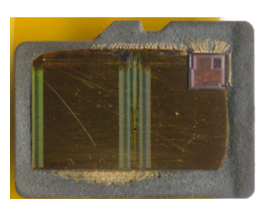
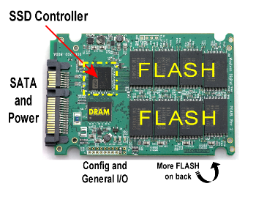
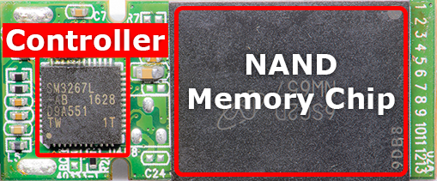
That’s a Lot of Work for an Embedded System!
Needs to maintain multi-GB/s bandwidth
Typical desktop SSDs have multicore ARM processors and gigabytes of memory to run the FTL
FTLs on smaller devices have sacrifice various functionality
MicroSD
SATA SSD
USB Thumbdrive
Thomas Rent, “SSD Controller,” storagereview.com
Jeremy, “How Flash Drives Fail,” recovermyflashdrive.com
Andrew Huang, “On Hacking MicroSD Cards,” bunniestudios.com

Slide 40
Lecture Summary
Pros (vs. hard disk drives):
Low latency, high throughput (eliminate seek/rotational delay)
No moving parts:
Very light weight, low power, silent, very shock insensitive
Read at memory speeds (limited by controller and I/O bus)
Cons
Small storage capacity – compared to HDD
Though the ratio is changing
Expensive compared to SSD
SSD: 10 cents per GB
HDD: 4-6 cents per GB
Asymmetric block write performance: read pg/erase/write pg
Controller garbage collection (GC) algorithms have major effect on performance
Limited Drive lifetime
1-10K writes/page for Multi level cell NAND
Avg failure rate is 6 years, life expectancy is 9–11 years

Slide 41
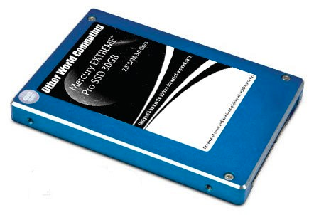
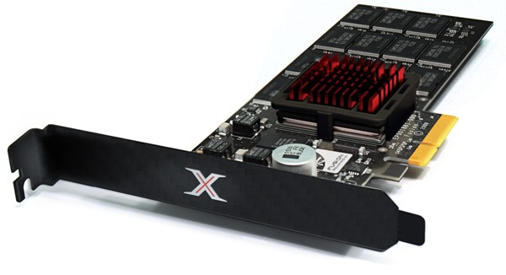
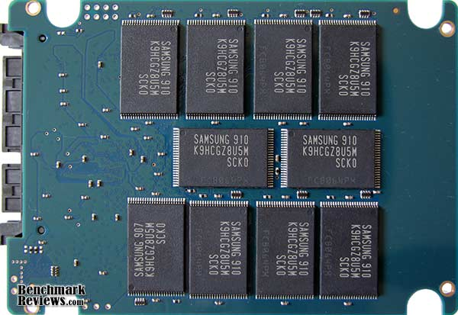
Solid State Disks (SSDs)
1995 – Replace rotating magnetic media with non-volatile memory (battery backed DRAM)
2009 – Use NAND Multi-Level Cell (2 or 3-bit/cell) flash memory
Sector (4 KB page) addressable, but stores 4-64 “pages” per memory block
Trapped electrons distinguish between 1 and 0
No moving parts (no rotate/seek motors)
Eliminates seek and rotational delay (0.1-0.2ms access time)
Very low power and lightweight
Limited “write cycles”
Rapid advances in capacity and cost ever since!
Very popular now
Phones, Cameras, thumb drive, laptops, slates etc

